Slide 1
ASSIGNMENT- 03
DATA ANALYTICS
TEAM ID: PNT2022TMID30061
MUTHAMIL M (610819205029)
B TECH - IT
Er. Perumal Manimekalai College Of Engineering Hosur.

Slide 2
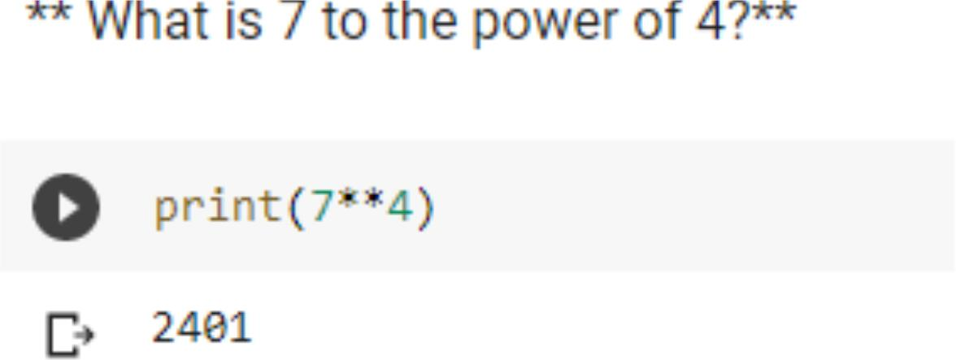
1

Slide 3
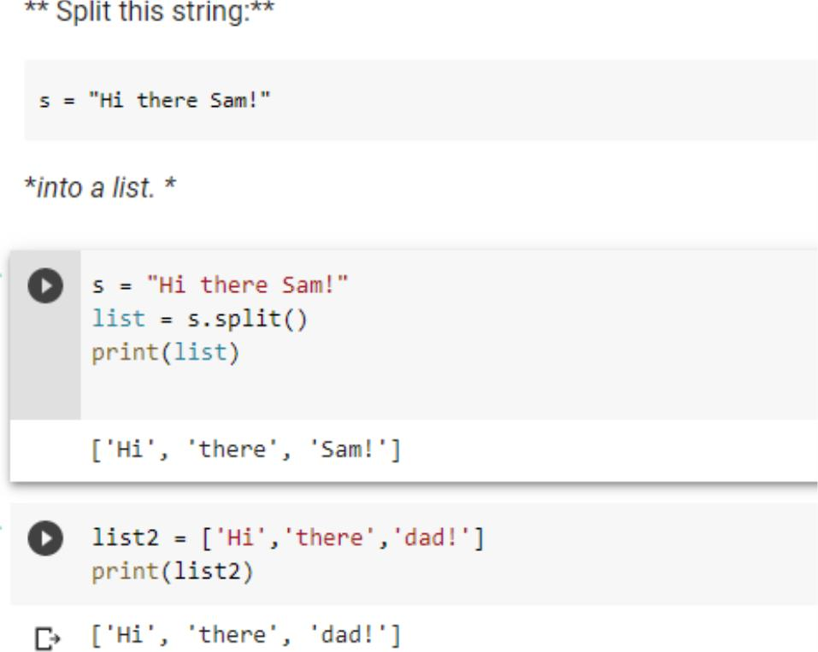
2

Slide 4
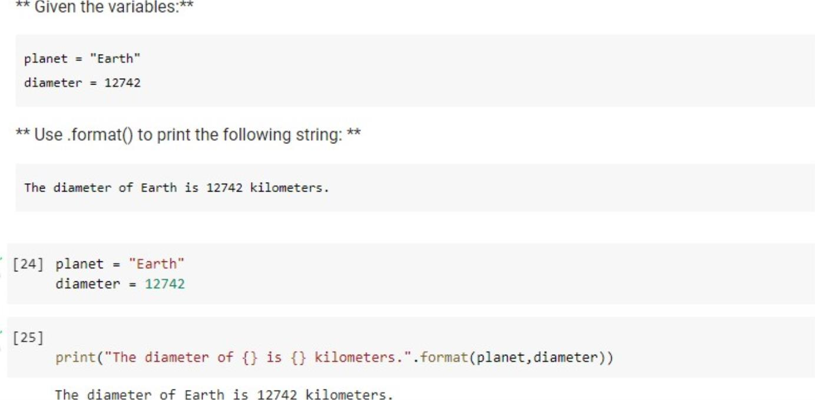
3

Slide 5
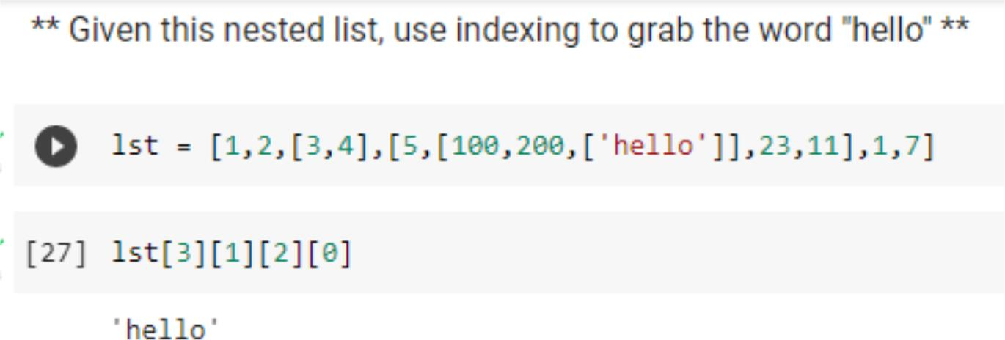
4

Slide 6
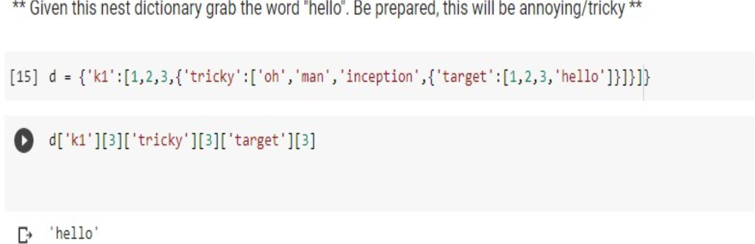
5

Slide 7
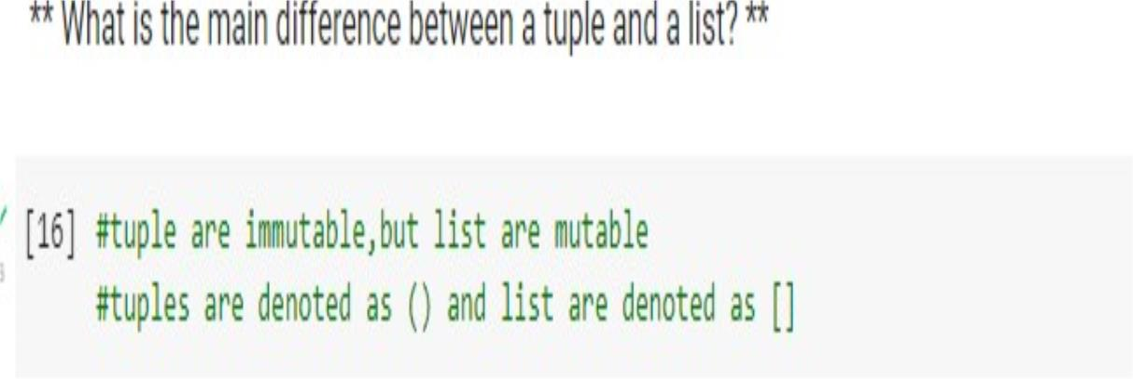
6

Slide 8
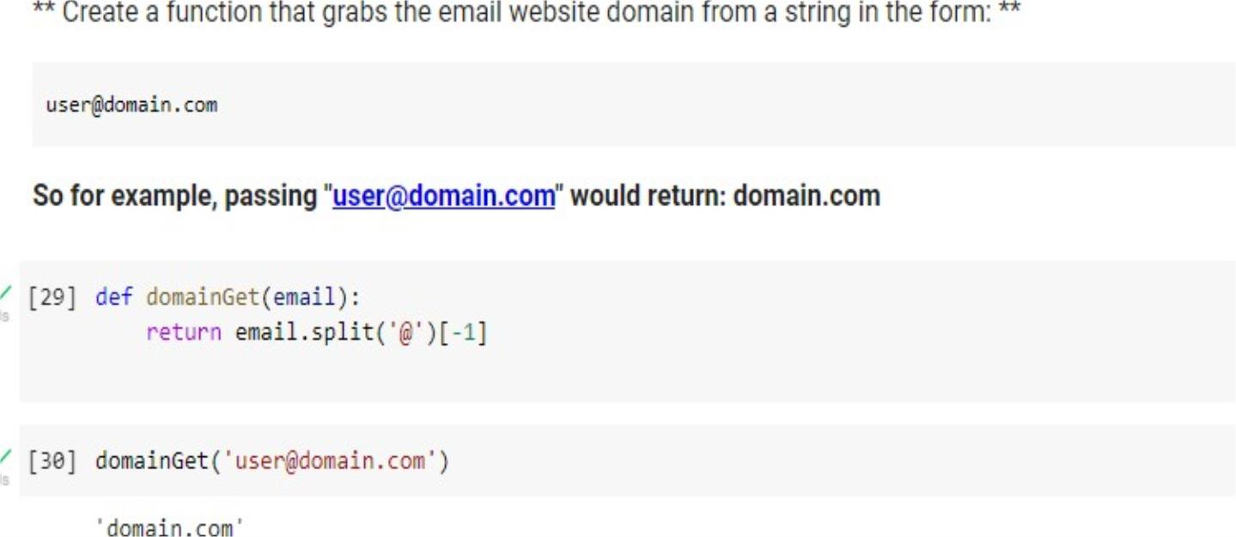
7

Slide 9
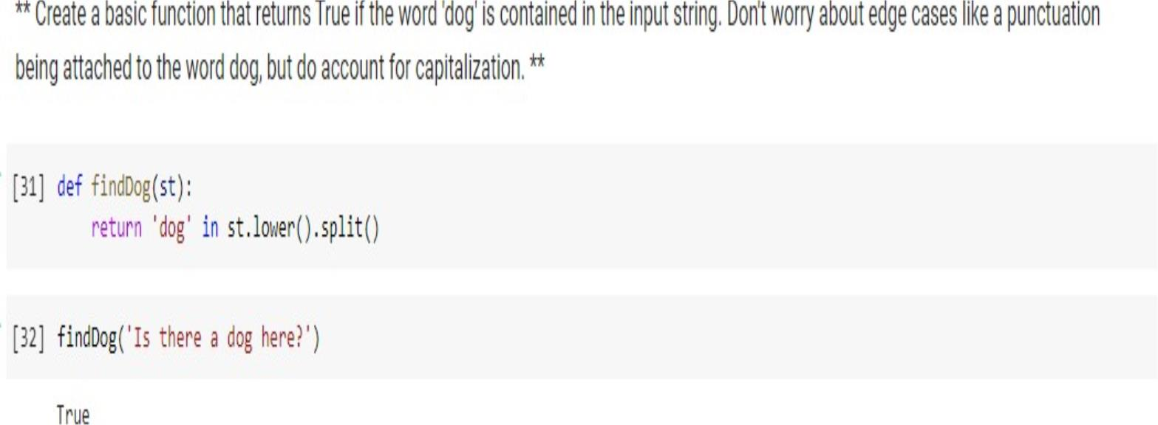
8

Slide 10
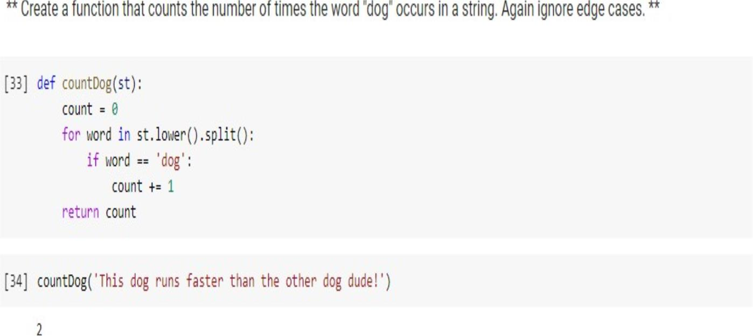
9

Slide 11
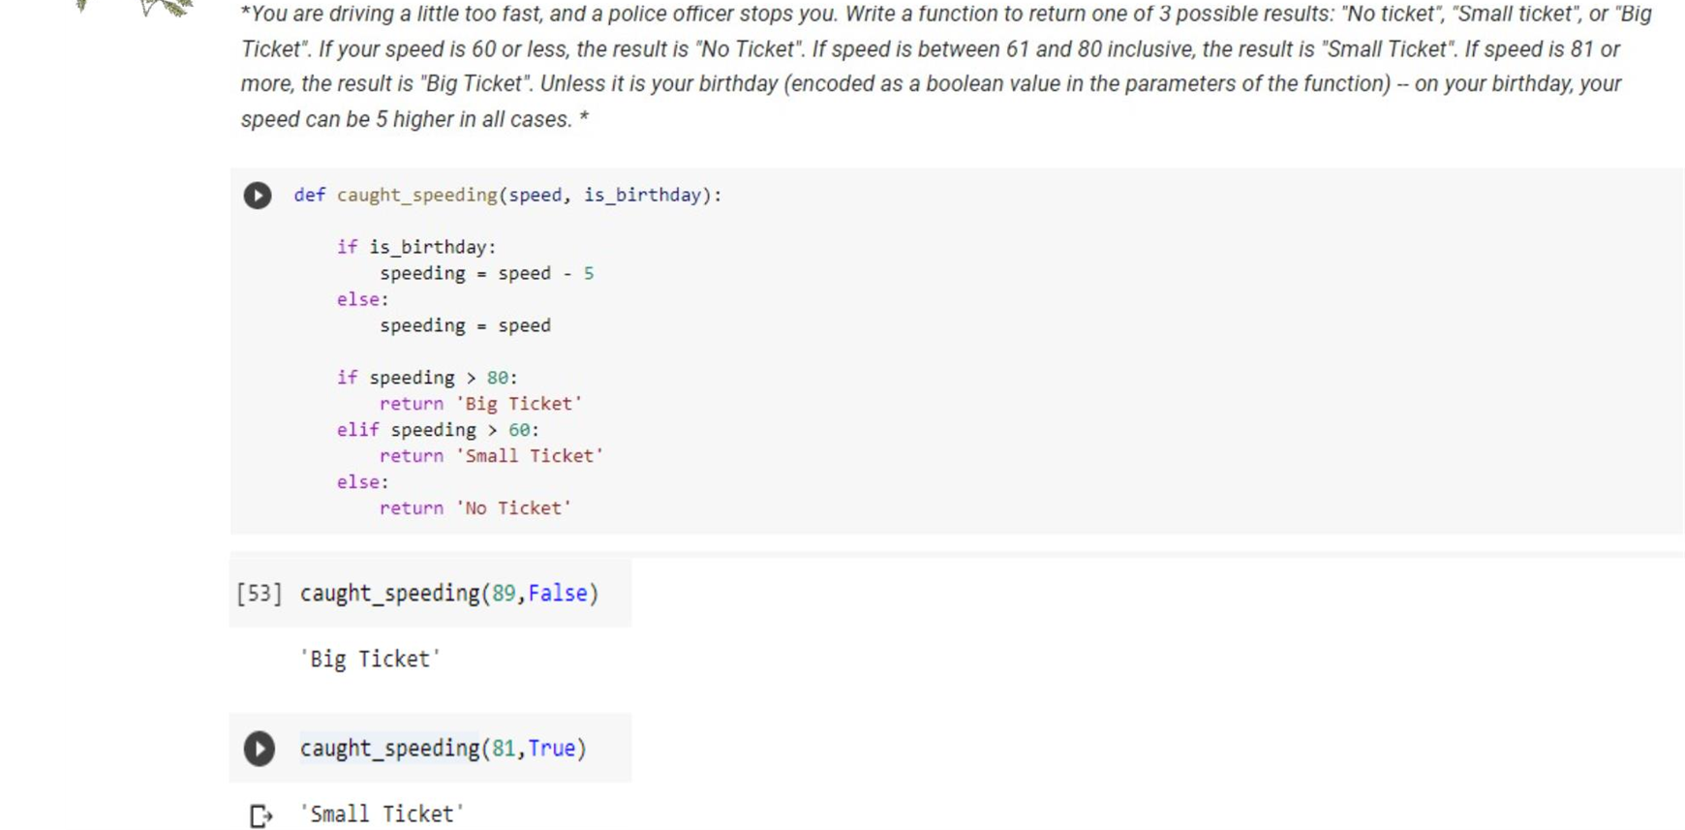
10

Slide 12
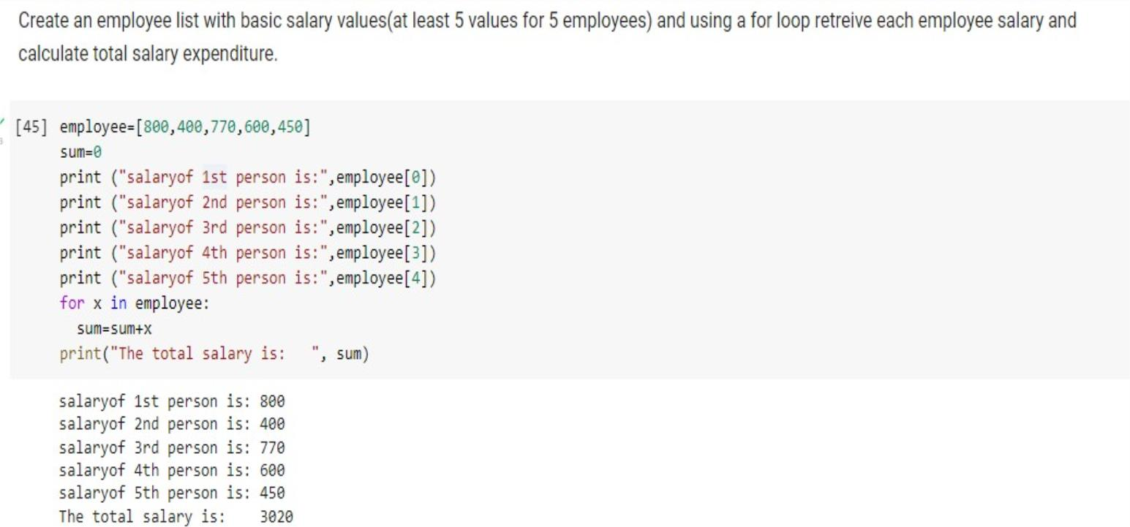
11

Slide 13
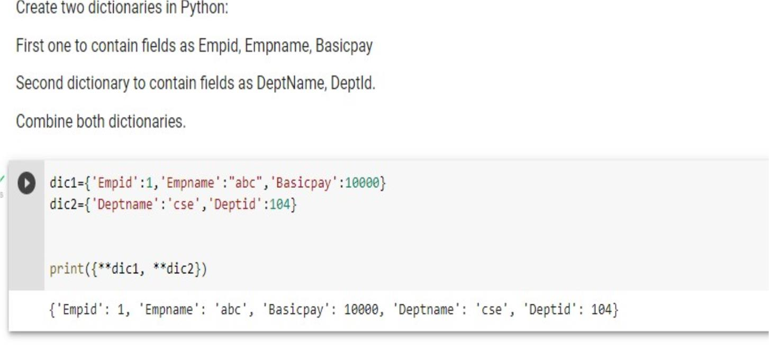
12

